Slide 1




PEERVIEW
Presented by: K. Aarya (23EG107E25)
S. Mahendhar (23EG107E54)
T. Indraneel (23EG107E62)

Slide 2
ABSTRACT
PeerView is an AI-powered project collaboration and review platform designed to help students and developers share, analyze, and improve their project ideas.
It enables users to upload projects, receive automated insights, and get peer feedback for enhanced learning.
With secure authentication, data is stored and managed using MongoDB. PeerView encourages teamwork through team requests and promotes knowledge exchange within the community.
Overall, PeerView simplifies peer-based evaluation and enhances project development efficiency.

Slide 3
TECHNOLOGIES USED
Backend Development
Node.js – Server-side JavaScript runtime environment for building scalable applications.
Express.js – Web framework used for routing, middleware handling, and API development.
Database
MongoDB – NoSQL database providing flexible and efficient data storage.
Mongoose – ODM library used for defining schemas and managing MongoDB collections.
Frontend Development
EJS (Embedded JavaScript Templates) – Templating engine for dynamic HTML rendering with embedded JS logic.
CSS – Used for responsive design, styling, and layout customization.
JavaScript – Enables client-side interactivity and seamless user experience.

Slide 4
ADDITIONAL TOOLS
Visual Studio Code (VS Code) – Integrated development environment for coding and debugging.
MongoDB Compass – GUI tool for managing and visualizing MongoDB data.
Git & GitHub – For version control and collaborative development.
npm (Node Package Manager) – Used for installing and managing project dependencies.

Slide 5
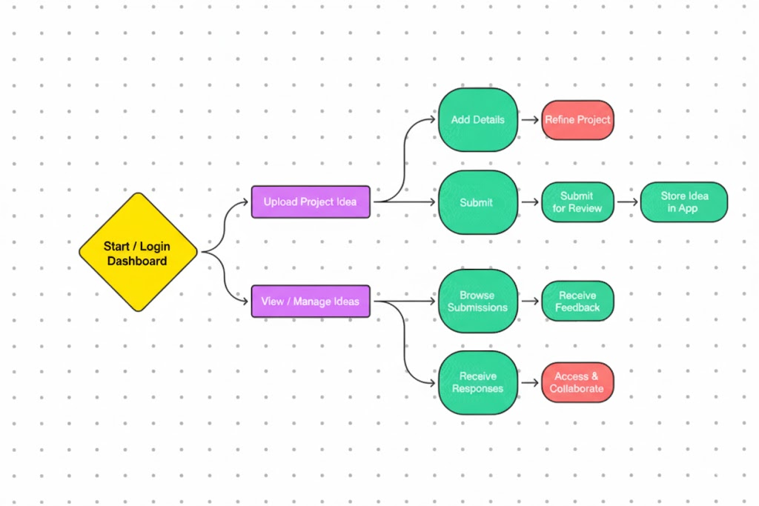
SYSTEM ARCHITECTURE FLOW

Slide 6
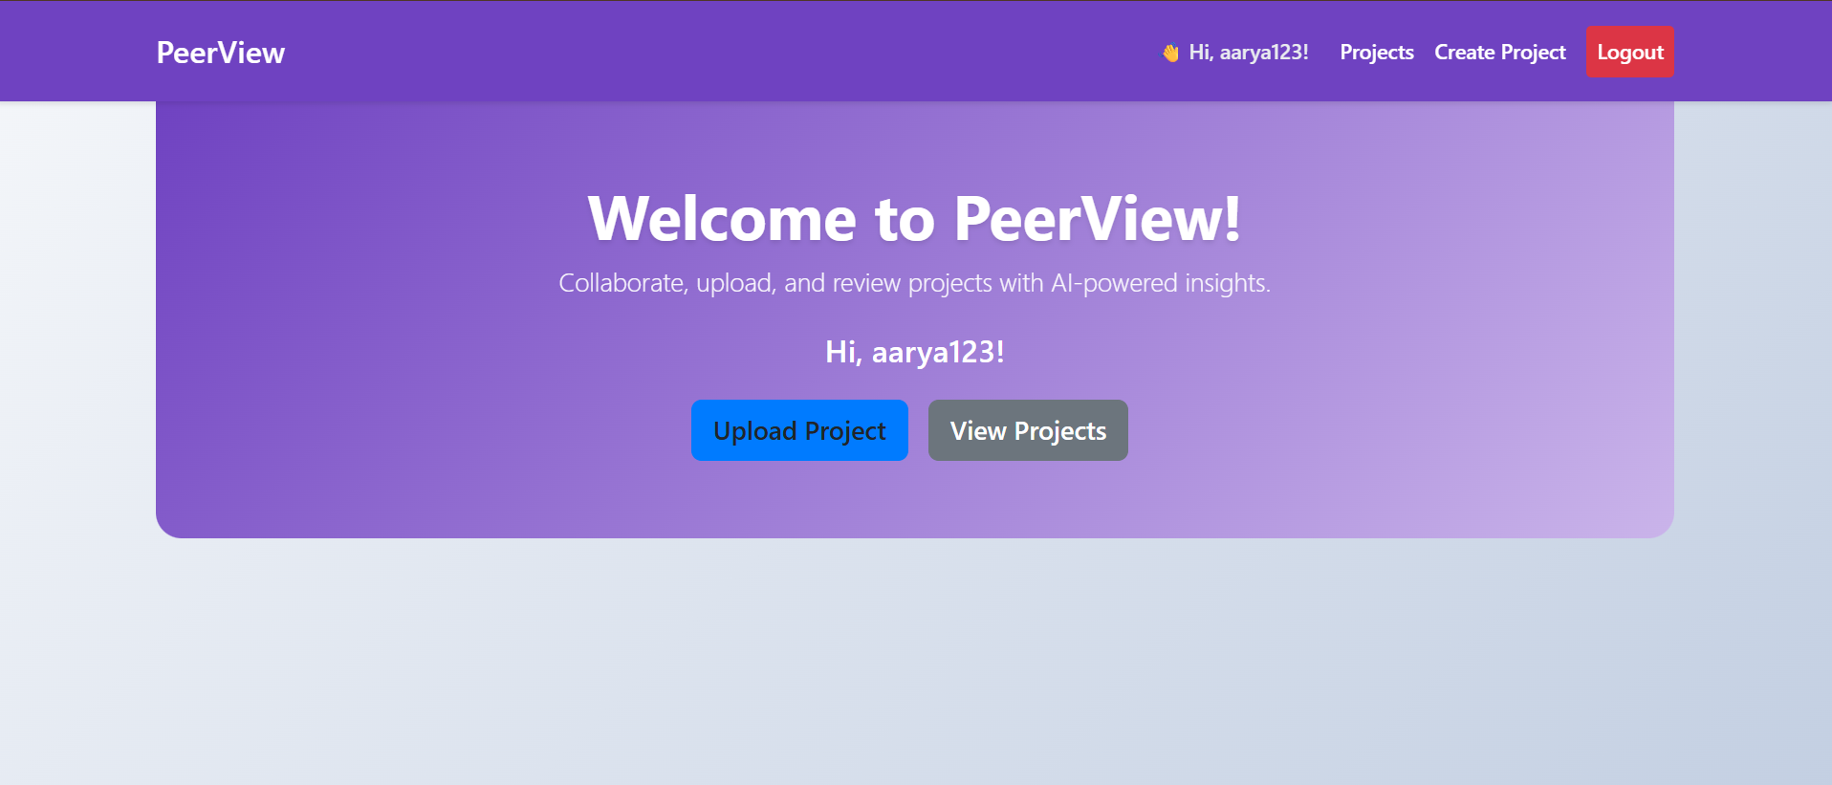
PAGES
HOME PAGE/ DASHBOARD

Slide 7
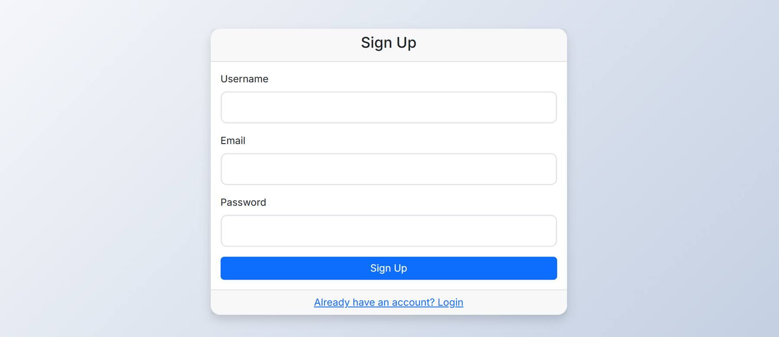
PAGES
2. SIGNUP PAGE

Slide 8
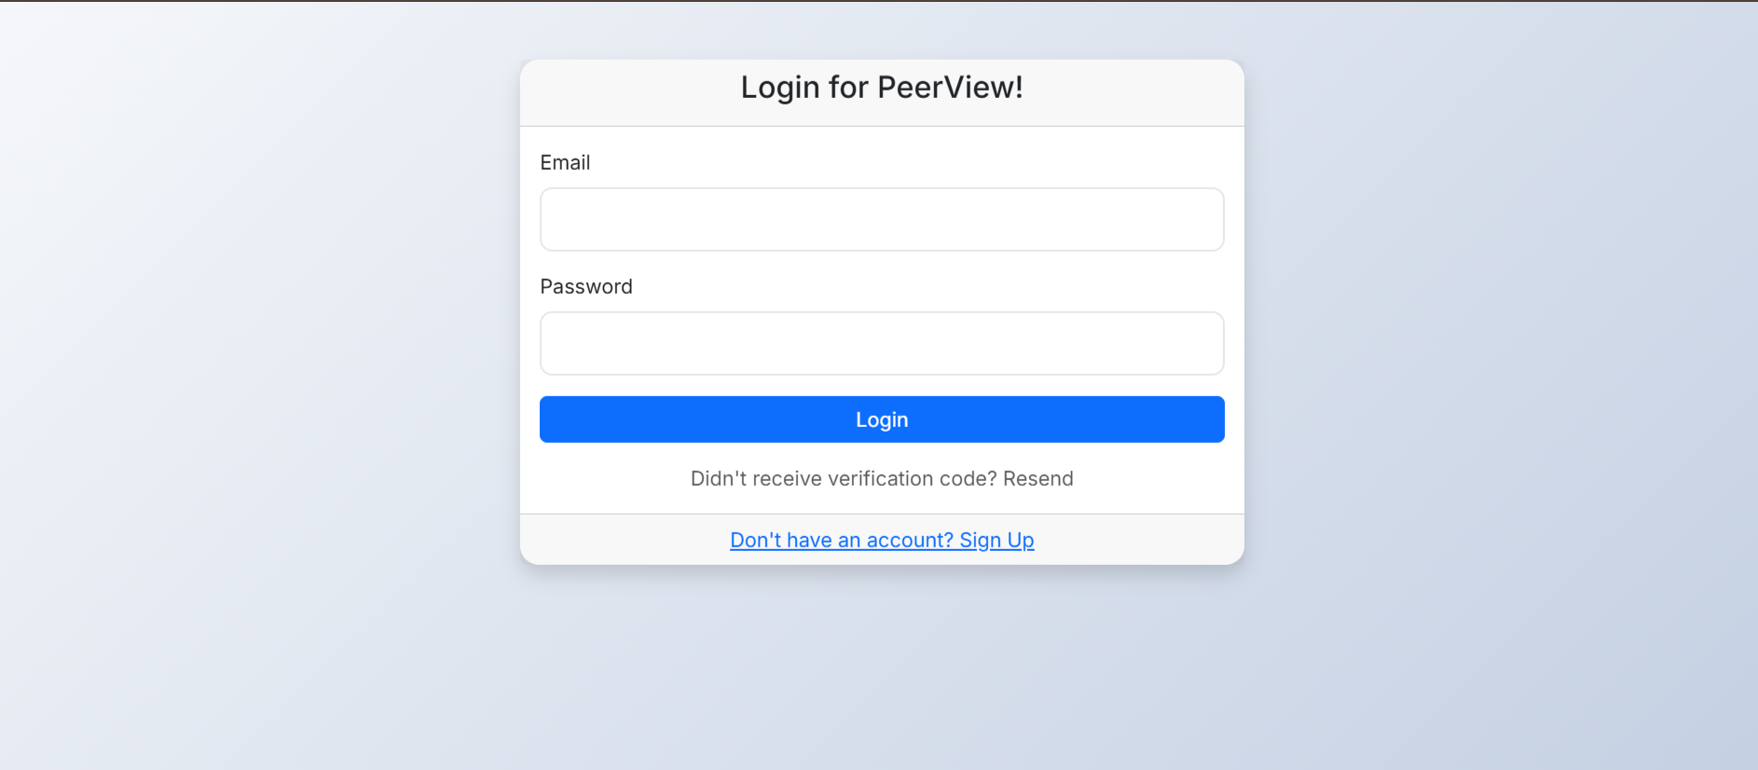
PAGES
3. LOGIN PAGE

Slide 9
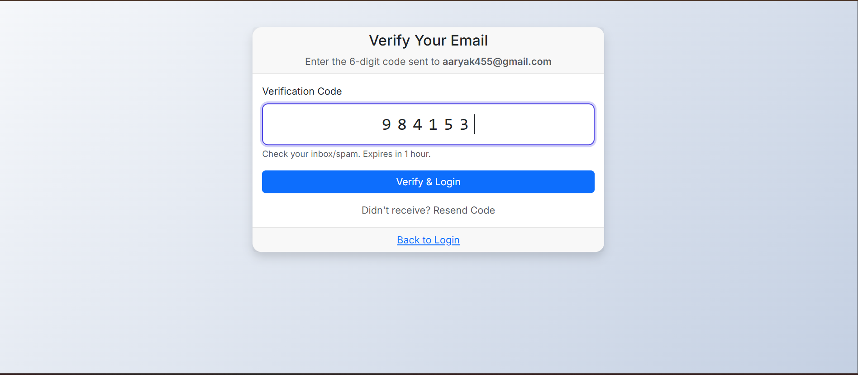
PAGES
4. VERIFY PAGE

Slide 10
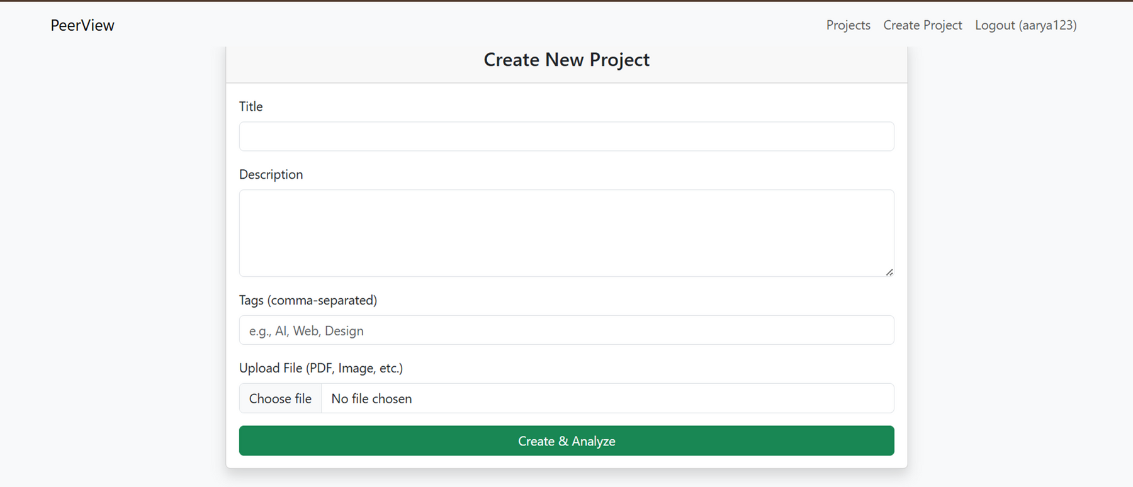
PAGES
5. CREATE-PROJECT PAGE

Slide 11
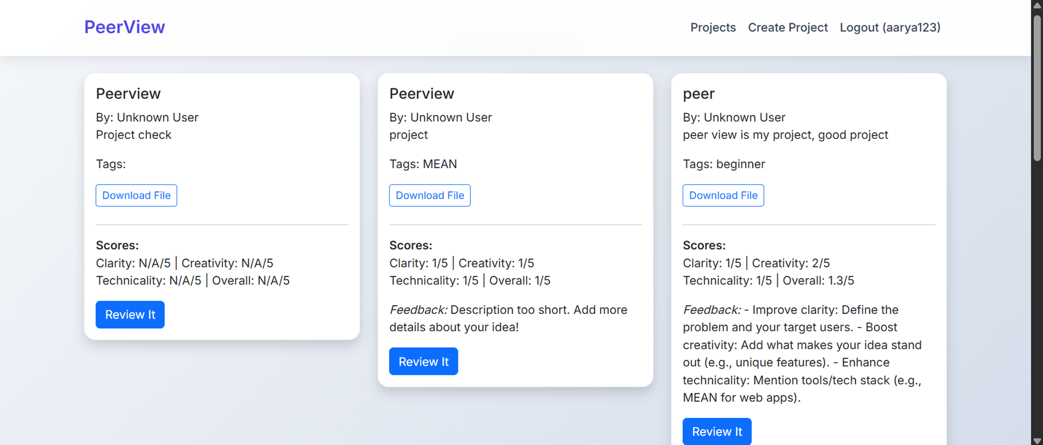
PAGES
6. PROJECTS

Slide 12
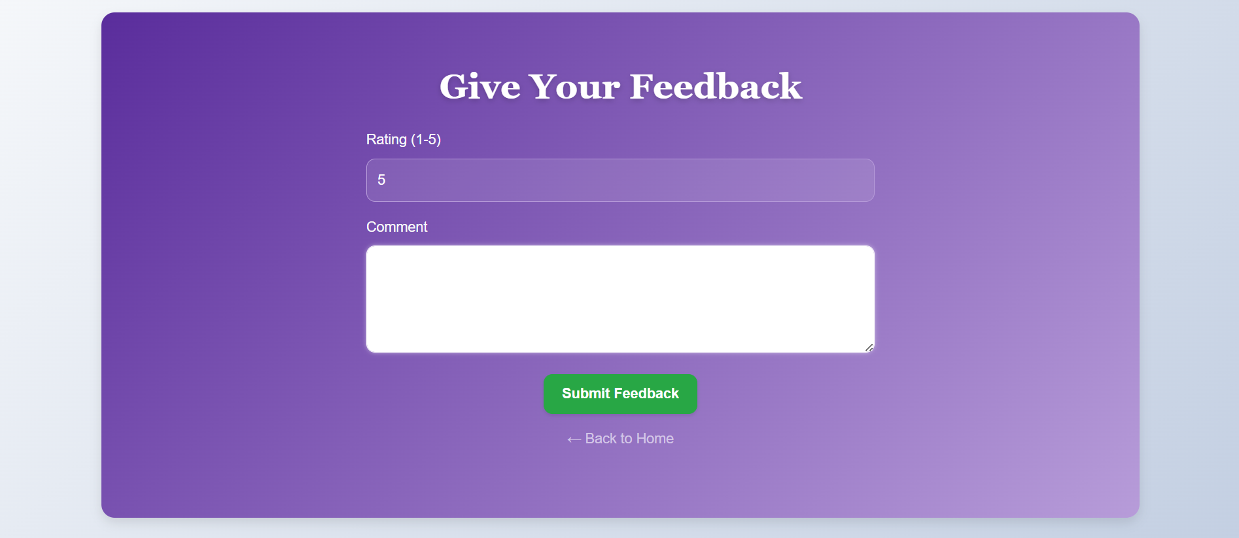
PAGES
7. FEEDBACK

Slide 13
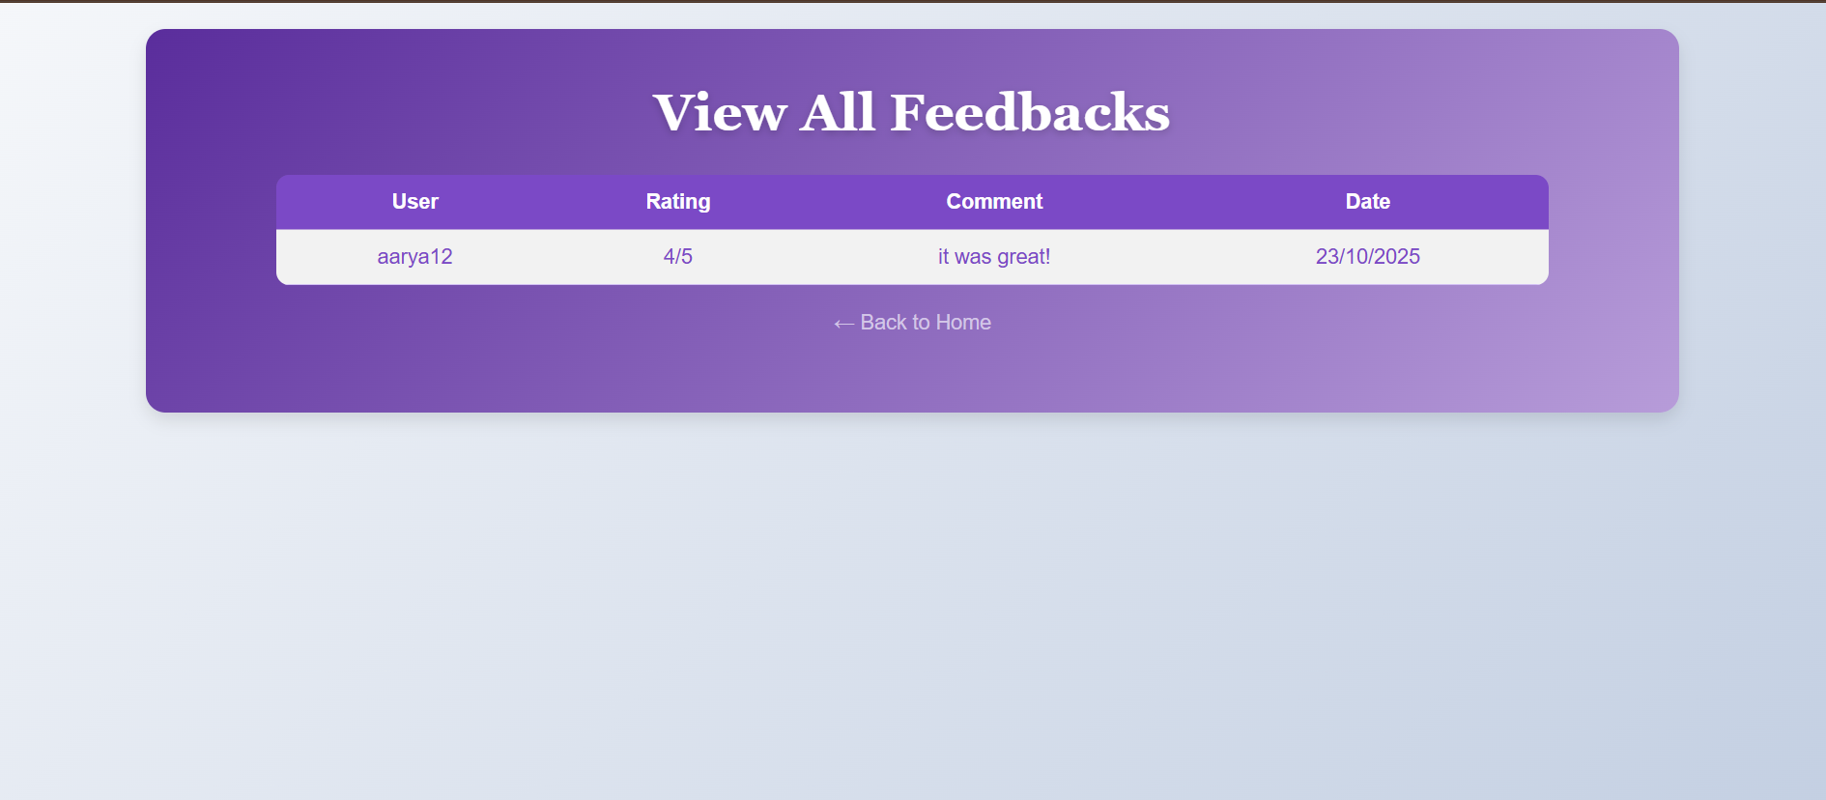
PAGES
8. FEEDBACKS

Slide 14
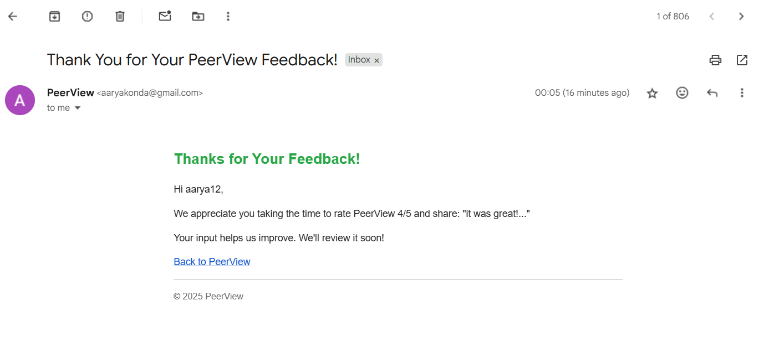
Receiving Feedback Emails

Slide 15
THANK
YOU

